Slide 1
European Trade Union Institute (ETUI)
Supporting, reinforcing and stimulating
the European trade union movement
„Training EWC delegates: experiences and methodologies“
Andrea Husen-Bradley, ETUI Education
Transnational workshop Project ITEM
17 June 2016, Brussels

Slide 2
ETUI: What we do
Research
Education and training
Conferences and debates
Expertise
Networks

Slide 3
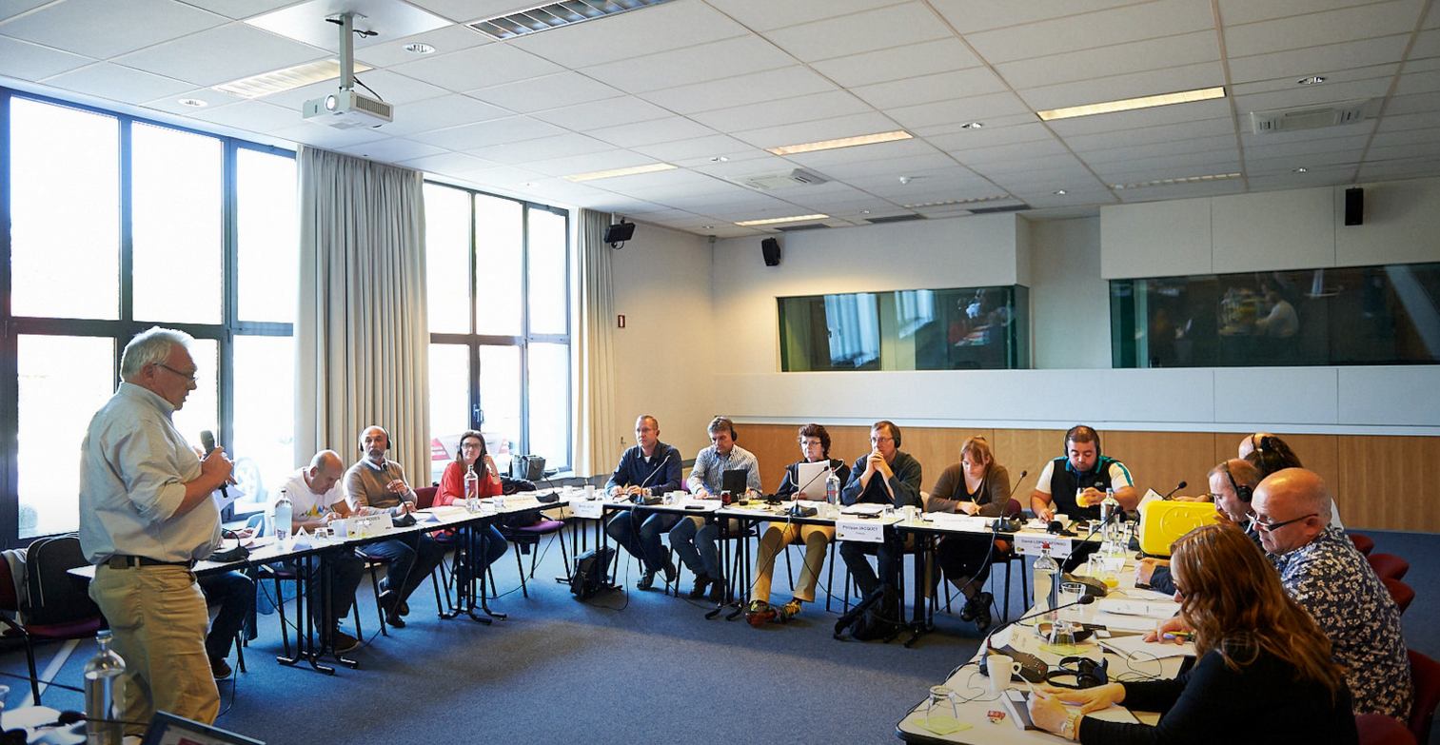
the ETUI EDUCATION DEPARTMENT
ETUI Education:
develops and delivers training courses for European
trade union officers and representatives
www.etui.org/Training
3

Slide 4
ETUI EDU – a snapshot
Annual work programmes
Cooperation with ETUC, ETUFs and national trade unions
About 100 courses for +2000 participants each year
Multinational tutor teams from ETUI trainer networks
Key courses:
  ‘Young Trade Union Leaders’
  ‘Project Management’
  ‘Training of Eurotrainers’
  ‘Language training for trade unionists’
  ‘Seminars for EWC and SE-works council members’
Thematic training on demand
Tailor-made training for your EWC, SE Works Council and SNB!
4

Slide 5
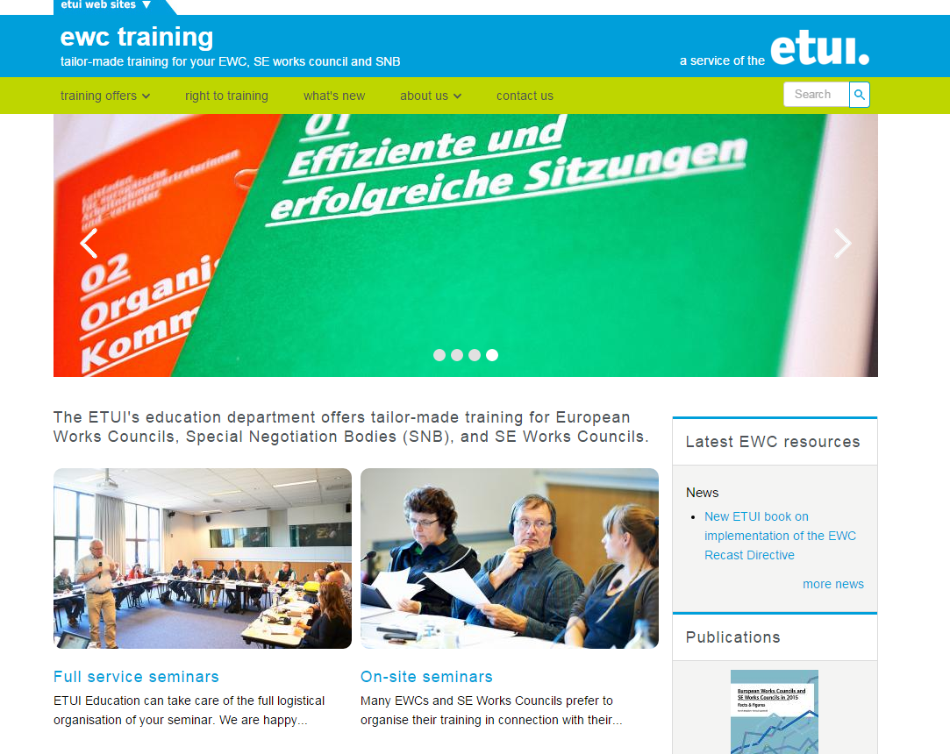
New EWC training website
www.ewctraining.eu

Slide 6
ETUI Education: EWC Training
Why are we involved?
Promoting worker participation is a key political priority for the ETUC, ETUFs and national trade union organisations
ETUI’s mission: strengthening the identity, the competences and the knowledge of the European Trade Union movement
Our ambition: to be key provider for trade union oriented EWC and SE-works council training at the European level
  Closely follow ETUC & ETUF policies on EWCs
  Partnership & support for national unions
  A training based on a common European trade union strategy

Slide 7

ETUI Education: EWC Training
  right to training

Slide 8
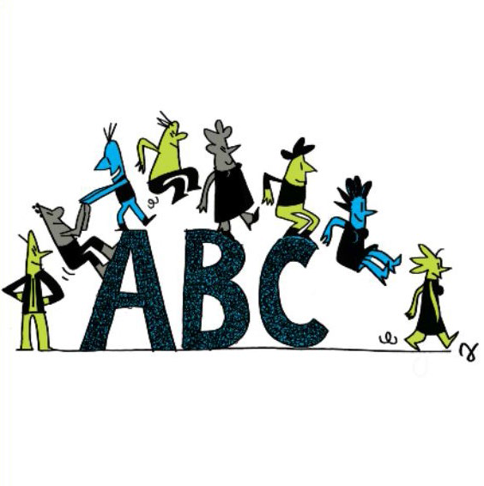
ETUI Education: EWC Training
target groups
1093 European Works Councils
Special Negotiating Bodies
(currently ~50)
Representative Bodies in 123 SEs
BLER in 64 SE boards
support for ETUF/local TU initiatives
source : www.ewcdb.eu & www.ecdb.worker-participation.eu June 2016

Slide 9










ETUI Education: EWC Training
training at national or European level ?
EWC
???
9

Slide 10




ETUI Education: EWC Training
training objectives:
the EWC = the centre of a communication network

speak with
one voice
local mgt
central mgt
influence decisions
national
representatives
SE WC
EWC
supervisory
board
SC
local
staff
collectively represent the
interests of the employees
European
trade union
federations
national
unions

Slide 11
ETUI Education: EWC Training
training methods and principles
  made-to-measure
  interactive based on active learning methods
  inclusive
  trade union inspired
  delivered by experienced trainers and practitioners
  quality service for a fair price
  capitalizing on in-house expertise and partners
  modular pathways
rules of the game
improving performance
strengthening action
enlarging the scope
11

Slide 12





ETUI Education: EWC Training
legal framework
rights and competences
when is an issue transnational?
how to (re)negotiate an agreement
discovering the potential
content of an EWC agreement
actors around the EWC
support by the European
Trade Union Federations
worker representation systems
rules of
the game
?
SNB

Slide 13
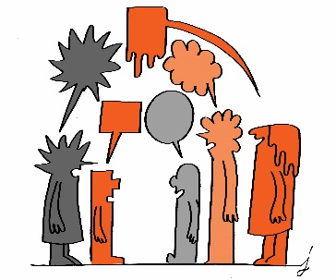








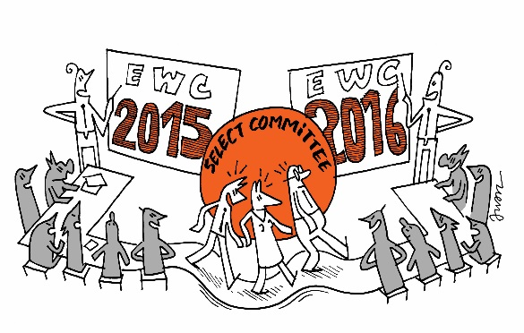
ETUI Education: EWC Training
how to organise a meeting
evaluation of the EWC practice
linking the European
and the national level
setting internal rules
competences of the
Select Committee
communication
cultural diversity
examples of other EWCs
improving performance
13

Slide 14


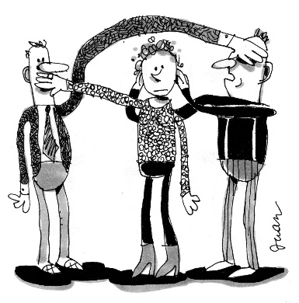


ETUI services training
ETUI Education: EWC Training
occupational health & safety
confidentiality
restructuring
collective redundancies
conflict management
innovation
corporate social
responsibility
strengthening action

Slide 15

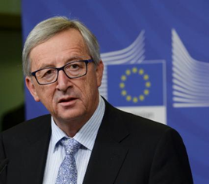

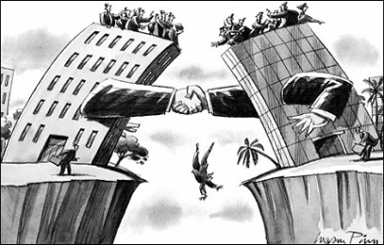

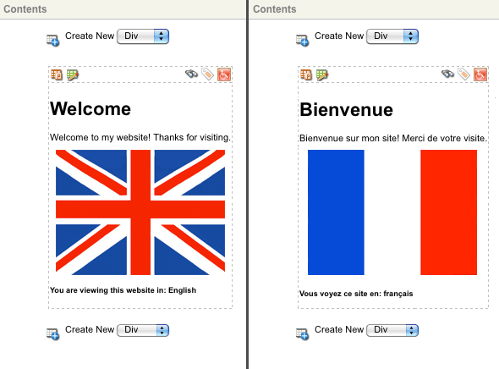
ETUI services training
ETUI Education: EWC Training
future?
company strategies
European institutions
scenario building
financial analysis
global framework agreements
English courses
cross-border mergers
board level representation
and much more…
enlarging
the scope

Slide 16
Q&A
more information:
www.ewctraining.eu
www.etui.org
or contact:
ewctraining@etui.org
info@etui.org

